Slide 1
Logistic Regression ML Model
By Amrita Panjwani

Slide 2
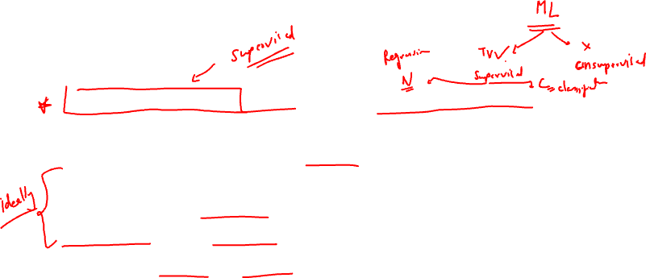
Definition
Logistic regression ML model is a classification algorithm. In classification the target variable is categorical. It has different categories also known as classes.
The important part of logistic regression is that it works ideally when there are only two classes in the output variable. Hence it is called Dichotomous or Binary.
Example: Yes/No , Pass/Fail , Spam/No Spam , Fraud transaction/Safe transaction, Survived/ Not Survived

Slide 3
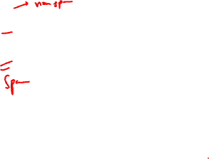
Decisions:
In logistic regression the two classes are defined as success and failure.
0 denotes ‘Failure’
1 denotes ‘Success’

Slide 4
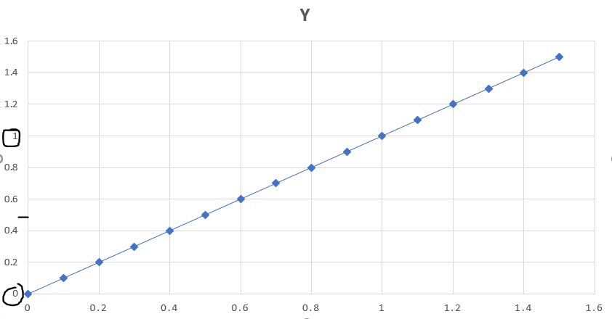
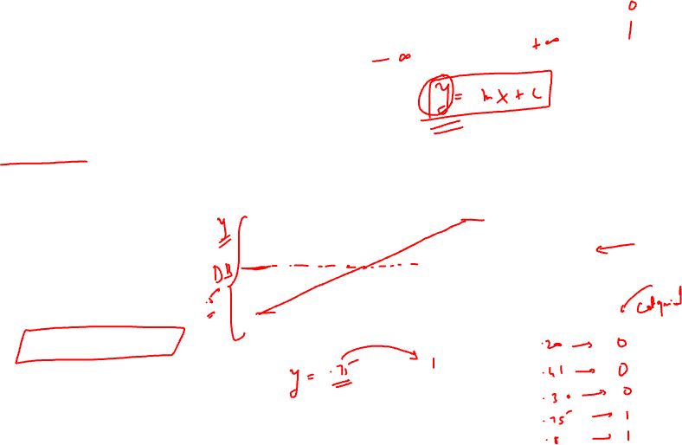
Why is it called ‘regression’?
It is a classification model , not a regression model.
But the underlying concept is based on linear regression.
Here the aim is to create the best fit line, and then limit its values between 0 and 1 only.
Then the decision boundary is created in the middle at 0.5

Slide 5

Now if the target value is greater than decision boundary , it is considered as 1 and if it is less than decision boundary then it is considered as 0.
A decision boundary of 0.5 , ensures that the division happens right from the mid-point leading to unbiasedness.
So if target value is 0.75 ~~ 1
And if target value is 0.35 ~~ 0
Like this TV < 0.5 ~~ 0 & TV > 0.5 ~~ 1

Slide 6
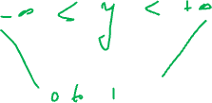
Hence we can conclude that the regression model classified the line into two categories that is the reason why logistic regression is called a classification model.
Selection of decision line as the mid-line is important
In this model the acceptable value of target variable (Y) is 0 or 1.

Slide 7
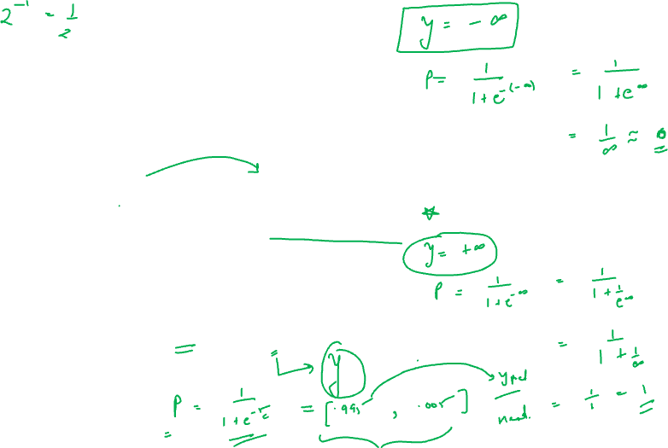
For linear regression the value of Y varies from
Hence we need a function such that:
The function that helps us do so is called Sigmoid function
Where: P is sigmoid function
e is euler’s number
Y is the response variable

Slide 8
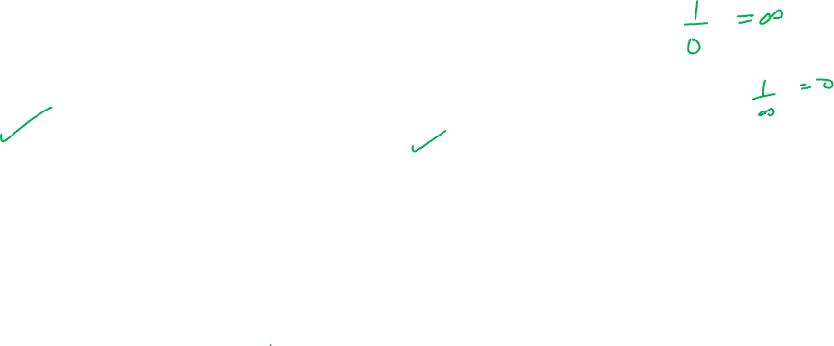
How does sigmoid function help?
In Sigmoid function plug in Y =
In Sigmoid function plug in Y =
Hence it can be seen that a sigmoid function converts the limits of Y to (0,1)

Slide 9
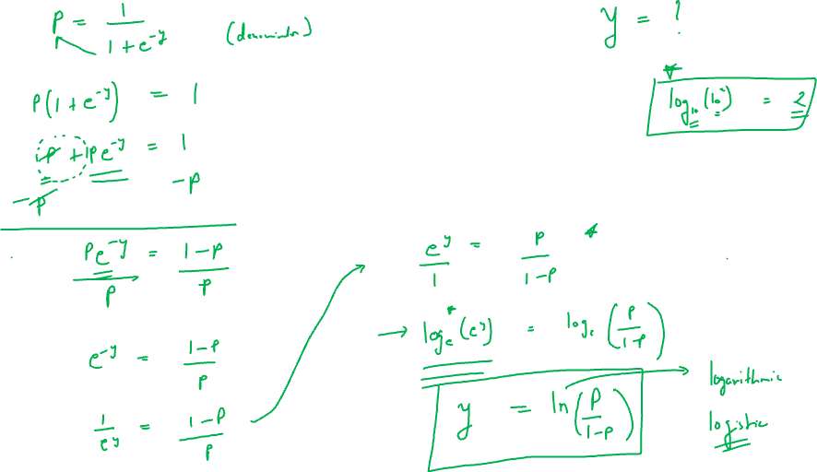
Transformation of sigmoid function

Slide 10
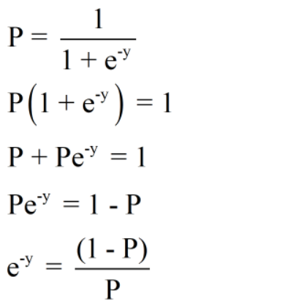
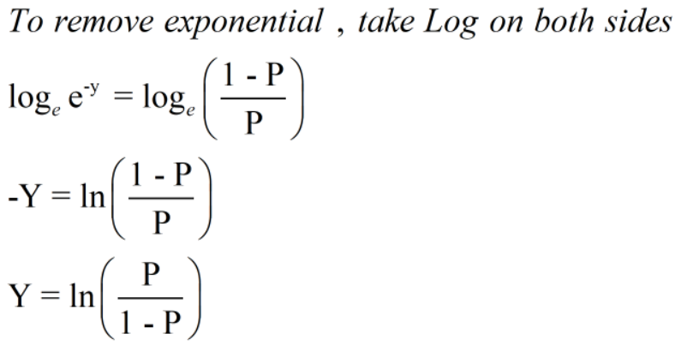
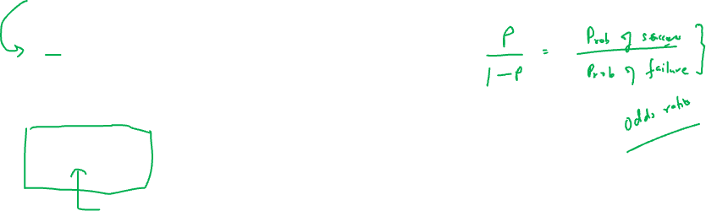

Slide 11
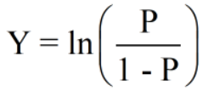
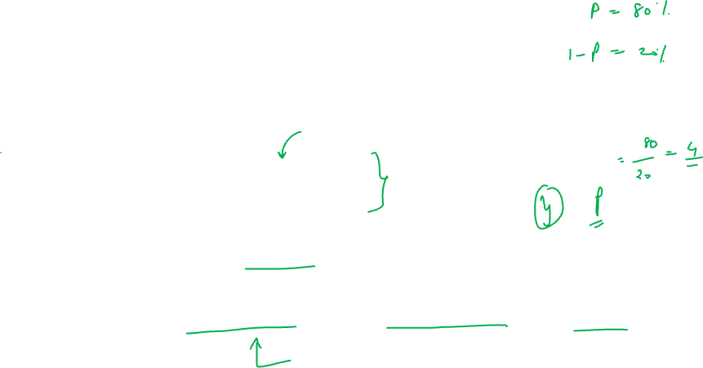
Hence we have converted the sigmoid function such that now it is expressed as providing the value of Y that is the target variable
Here (P/(1-P)) is called “odds ratio”.
Hence Y can be defined as log of odds ratio.
Y is also called as Log Odd Function or Logistic Function or Logit Function

Slide 12
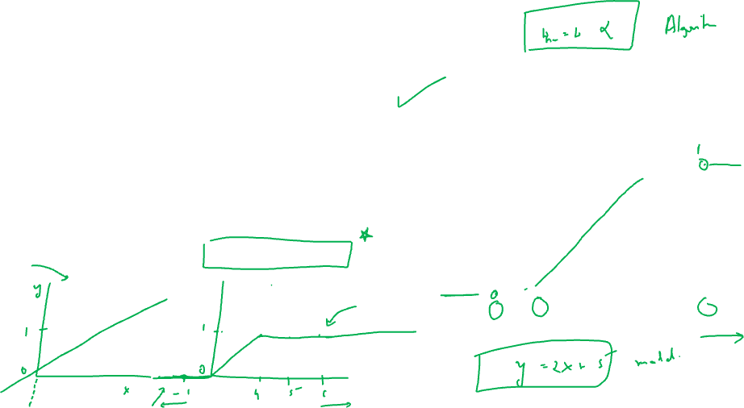
Graph of sigmoid function
If the sigmoid function P is plotted on the graph , it can be observed that the curve lies between 0 and 1 on the Y axis.
Hence it gets a S shaped curve.

Slide 13
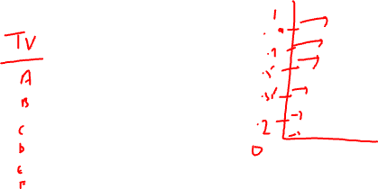
Can logistic regression be used for multiclass classification?
Suppose if I work with an output variable that has 6 classes: A, B , C , D , E and F
First step: classify as A and Not A(this includes B, C D, E and F)
Second step: classify Not A as : B and Not B(this includes C, D E and F)
Third step: Classify Not B as : C and Not C
And so on…

Slide 14
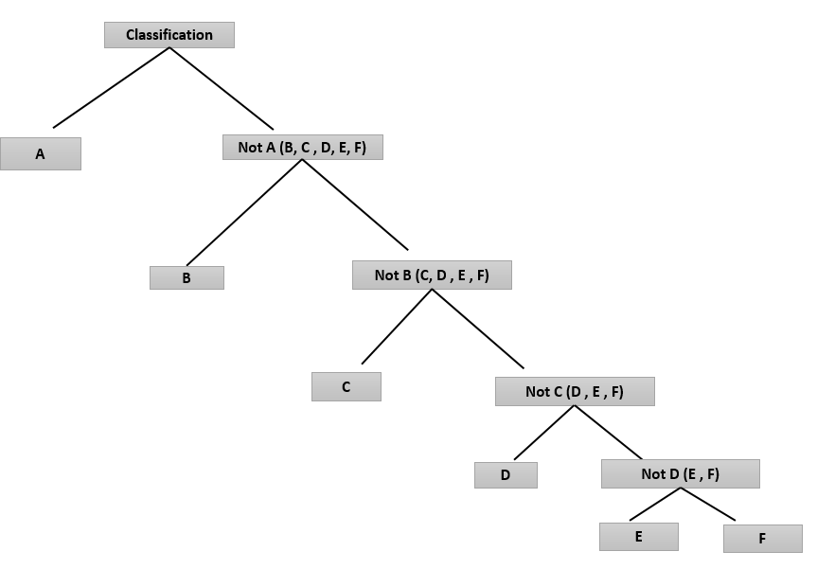
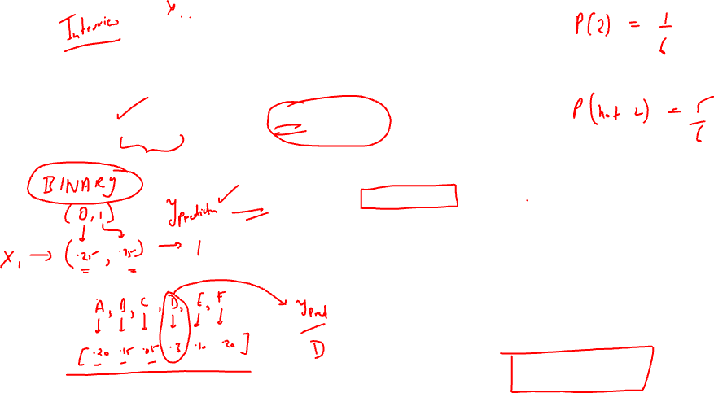

Slide 15
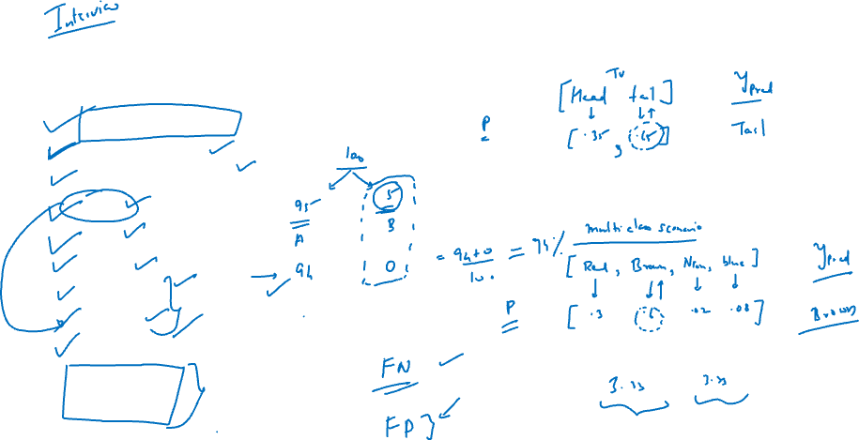
Evaluation Matrix for Classification Model
Confusion matrix
Accuracy
Misclassification
TPR
FPR
TNR
Precision
Recall
F1 score
ROC curve
AUC

Slide 16
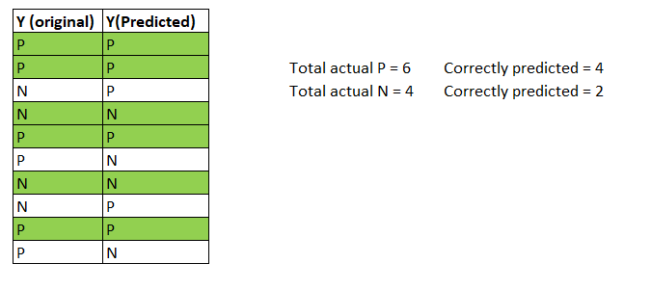
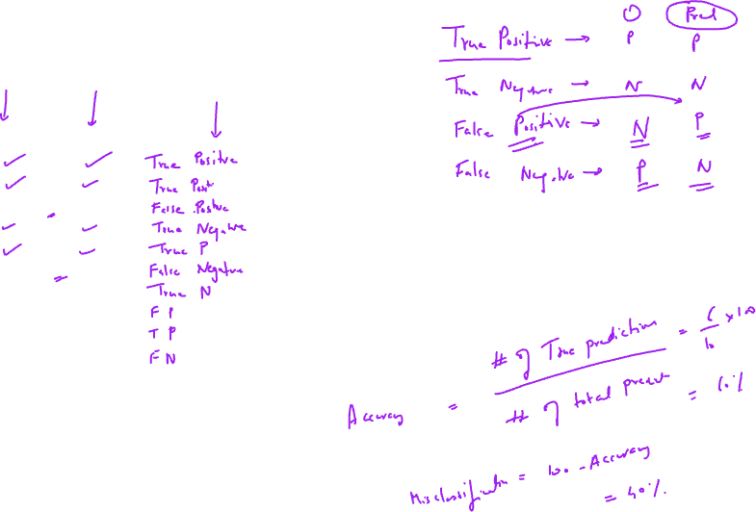

Slide 17
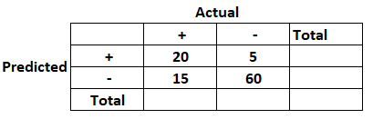
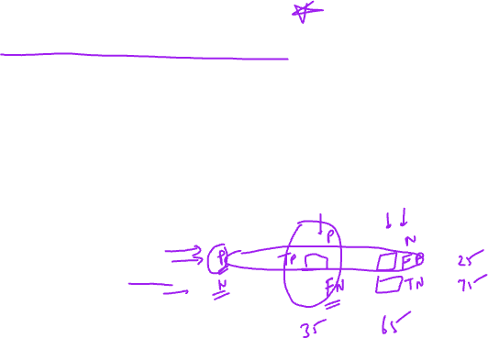
Confusion Matrix
Covid cases: There are two aspects.
One actual fact: whether a person has covid or not
Second predicted result: whether the test came positive or not
The above table so obtained by tabulating the actual counts vs the predicted counts is called confusion matrix

Slide 18
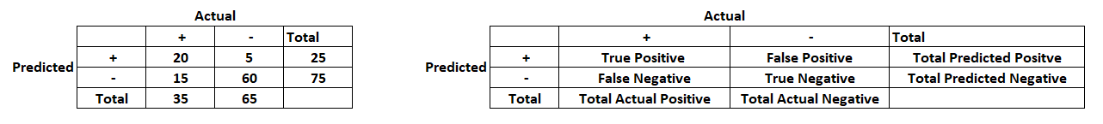
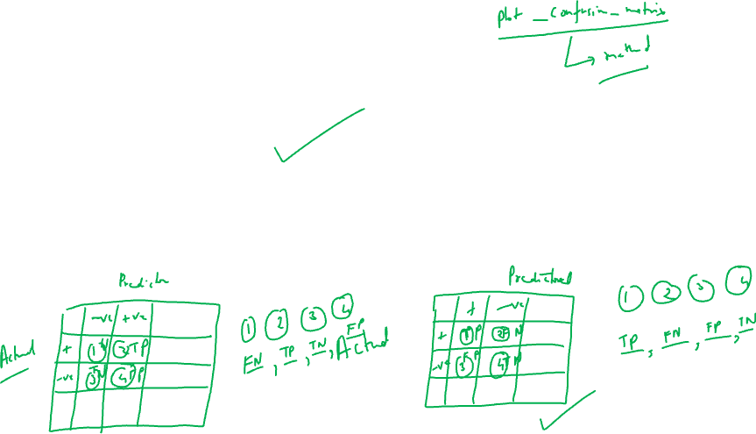
Confusion matrix

Slide 19
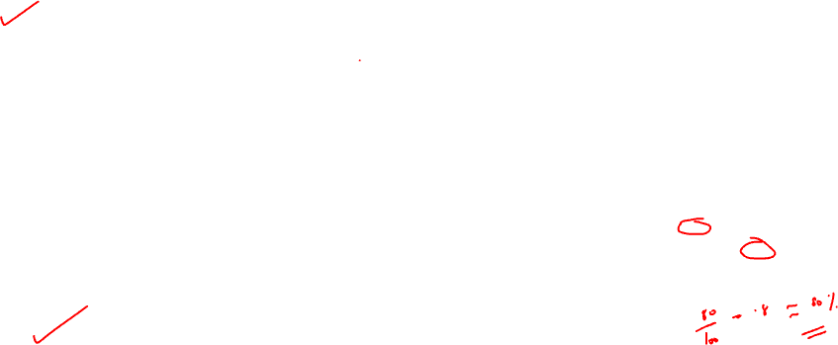
Accuracy of the model
It is defined as the ratio of correct predictions to total predictions.
Total number of correct predictions = TP + TN
Total Predictions = sum of all 4 cells

Slide 20
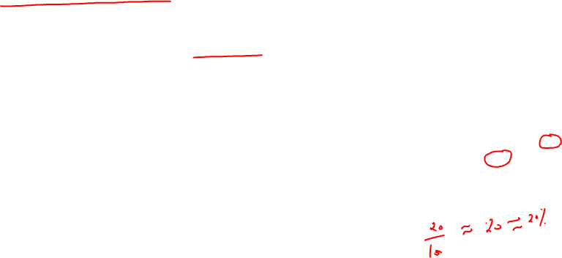
Misclassification
It is defined as the ratio of incorrect predictions to total predictions.
Total number of incorrect predictions = FP + FN
Total Predictions = sum of all 4 cells

Slide 21
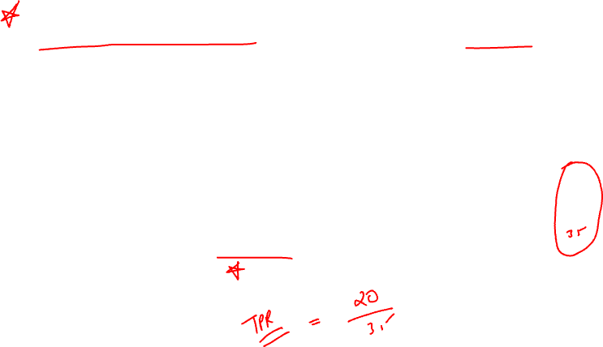
True Positive Rate (Also called ‘Recall’)
It is defined as the ratio of TP to total actual positives.

Slide 22
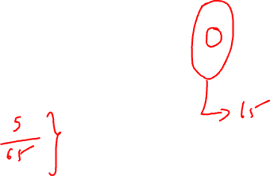
False Positive Rate
It is the ratio of FP to Total Actual Negatives

Slide 23
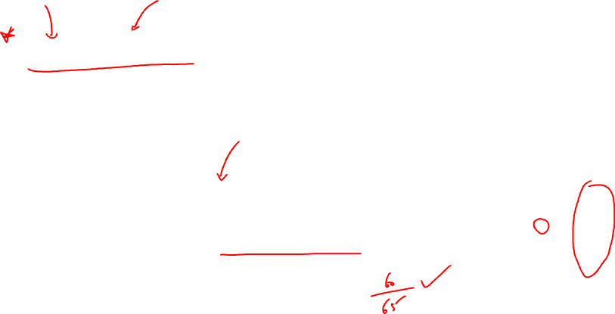
True Negative Rate
It is defined as the ratio of TN to Total Actual Negatives

Slide 24
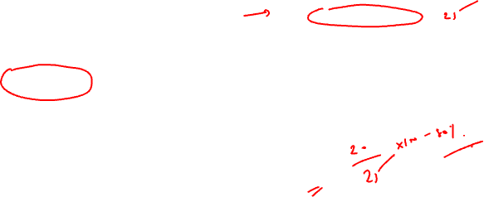
Precision of the model
It is defined as the ratio of TP to Total Predicted Positive
It is also known as positive predictive value

Slide 25
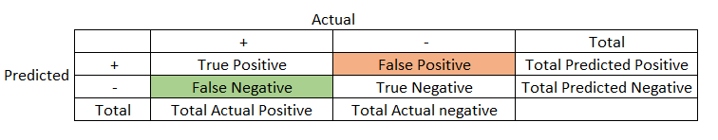
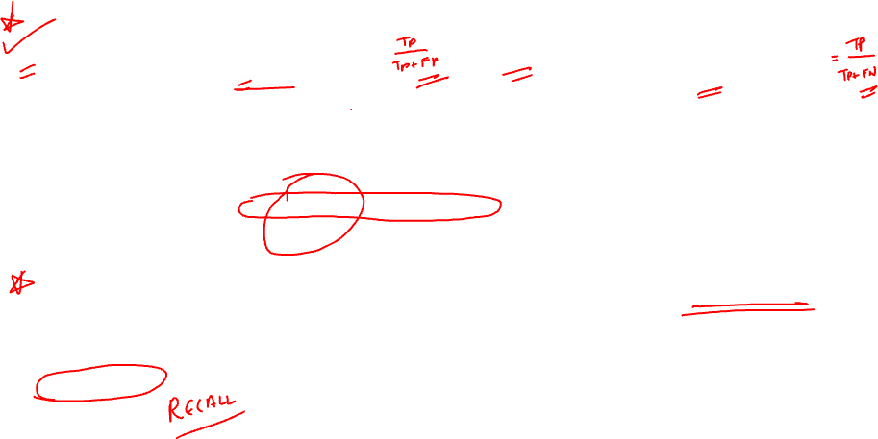
Difference between Precision and Recall
Precision relates the true positive to the predicted positives whereas recall or TPR relates the true positive to the actual positives
Use case of precision: Identifying a mail as spam. If a Business Mail is marked as spam , this is FALSE POSITIVE. This harms the business. Here Precision is used to evaluate the model.
Use case of recall: Identifying a transaction as fraud. If a wrong transaction is NOT marked as fraud , this is FALSE NEGATIVE. This harms the business. Here recall is used to evaluate the model.

Slide 26
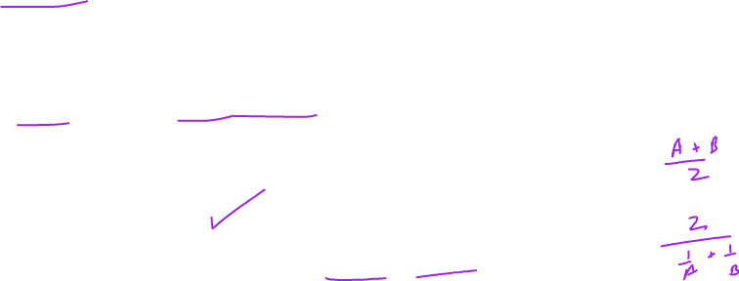
F1 Score
This is a measure that shows the combined effect of Precision & Recall
F1 score is the harmonic mean of Precision and Recall
When is F1 score used?
When False Positive and False Negative both are important parameters for the business F1 score helps.

Slide 27
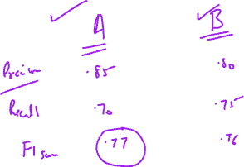
Drawback of F1 Score:
Interpretability of F1 score is difficult
We cannot individually comment about False Negative and False Positive
It is precisely used to compare two classifiers. If suppose model A has higher Precision and model B has higher Recall. In that scenario the F1 score of model A and B is compared.

Slide 28
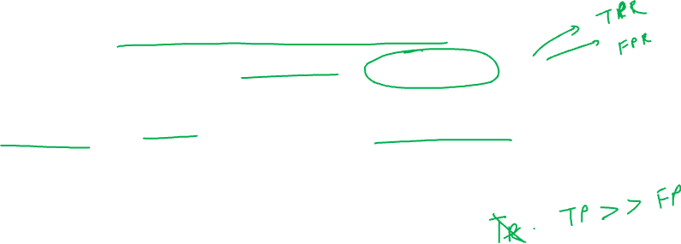

ROC Curve
ROC means Receiver Operating Characteristics.
This was initially used by operators of military radar in 1941 , that is why it is named as ROC
ROC curve is a graph plotted between TPR and FPR
In Machine Learning Classification models ROC helps to analyze the operating characteristics of the model.

Slide 29
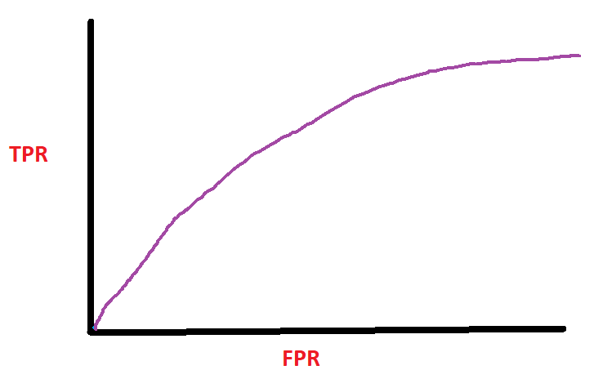
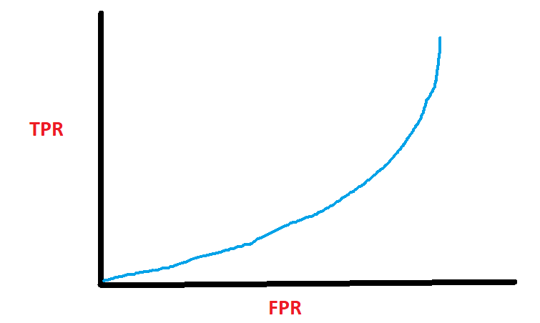
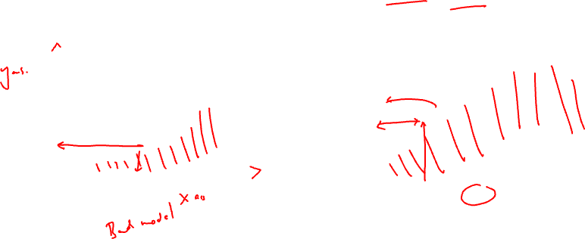
TPR < FPR
TPR > FPR

Slide 30
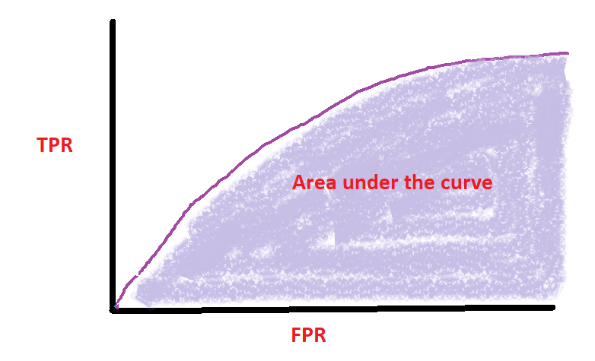
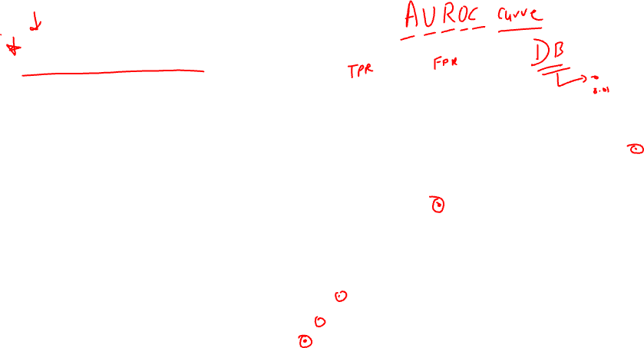
Area under the curve
Area under the curve is the total area under the ROC curve.
Higher the Area under the curve, higher is TPR and that indicates that the model is doing a good job!

Slide 31
